Slide 1
GREEDY METHODS
SUBMITTED BY - ABHINAV SINGH
roll no. – 181210001
DIMPAL KATANIYA
roll no. - 181210022
CSE 2ND YEAR

Slide 2
Greedy Methods:-
Greedy methods
Greedy algorithms build a solution part by part, choosing the next part in such a way, that it gives an immediate benefit. This approach never reconsiders the choices taken previously. This approach is mainly used to solve optimization problems. Greedy method is easy to implement and quite efficient in most of the cases but not in all the cases.
Examples:-
Knap sack algorithm
Huffman codes algorithm
Job sequencing with deadlines algorithm
Optimal merge pattern algorithm

Slide 3
(1.)Knap sack algorithm:
Greedy methods – knap sack algorithm
In this problem we will be given weights and values of n items, we need to put these items in a knapsack of capacity W to get the maximum total value in the knapsack.

Slide 4
Example problem:
Greedy methods – knap sack algorithm
A thief enters a house for robbing it. He can carry a maximal weight of 60 kg into his bag. There are 5 items in the house with the following weights and values. What items should thief take for maximum profit if he can even take the fraction of any
item with him?.
Item | Weight | Value
1 | 5 | 30
2 | 10 | 40
3 | 15 | 45
4 | 22 | 77
5 | 25 | 90

Slide 5
Solution:
Greedy methods – knap sack algorithm
Step-1:
Compute the value / weight ratio for each item-
Items | Weight | Value | Ratio
1 | 5 | 30 | 6
2 | 10 | 40 | 4
3 | 15 | 45 | 3
4 | 22 | 77 | 3.5
5 | 25 | 90 | 3.6

Slide 6
Step-2:
Greedy methods – knap sack algorithm
Sort all the items in decreasing order of their value / weight ratio-
I1 I2 I5 I4 I3
(6) (4) (3.6) (3.5) (3)

Slide 7
Step-3:
Greedy methods – knap sack algorithm
Start filling the knapsack by putting the items into it one by one.
now,
▪ Knapsack weight left to be filled is 20 kg
but item-4 has a weight of 22 kg.
▪ Since in fractional knapsack problem,
even the fraction of any item can be taken.
▪ So, knapsack will contain the following items-
< I1 , I2 , I5 , (20/22) I4 >
Knapsack Weight | Items in Knapsack | Cost
60 | Ø | 0
55 | I1 | 30
45 | I1, I2 | 70
20 | I1, I2, I5 | 160

Slide 8
Total cost of the knapsack:-
Greedy methods – knap sack algorithm
160 + (20/27) x 77
= 160 + 70
= 230 units

Slide 9
ALGORITHM:
Greedy methods – knap sack algorithm
Greedy-knapsack(w[1….n],p[1…n],m,n)
{
For i = 1 to n
compute pi/wi;
Sort objects in non-increasing order of p/w;
For i = 1 to n in sorted list
if(m>0 && wi<=m)
m = m-wi;
p = p + pi;
else break;
if(m>0)
p = p + pi(m/wi);}

Slide 10
Time complexity:
Greedy methods – knap sack algorithm
For computing pi/wi = O(n)
For sorting in decreasing order of pi/wi = O(nlogn)
For putting weigths in knap sack = O(n)
So time complexity for knap sack algorithm is O(nlogn).

Slide 11
(2.)Huffman codes algorithm:
Greedy methods – Huffman codes algorithm
We do require Huffman algorithm for compression of data so it could be transmitted over internet and other transmission channels properly.
Huffman algorithms work on binary trees.
Huffman code is a method for the construction of minimum redundancy codes.
Each code is a binary string that is used for transmission of corresponding message.
For example:-
BAGGAGE 100 11 0 0 11 0 101
Huffman algorithm
data
Huffman code

Slide 12
Example problem:
Greedy methods – Huffman codes algorithm
A file contains the following characters with the frequencies as shown. If Huffman Coding is used for data compression, determine-
Huffman Code for each character
Average code length
Length of Huffman encoded message (in bits)
Characters | Frequencies
a | 10
e | 15
i | 12
o | 3
u | 4
s | 13
t | 1

Slide 13

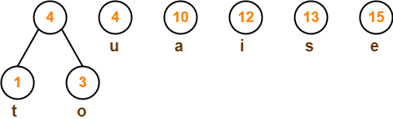
Solution:
Greedy methods – Huffman codes algorithm
First let us construct the Huffman Tree.
Huffman Tree is constructed in the following steps-
Step 1:
Step2:

Slide 14
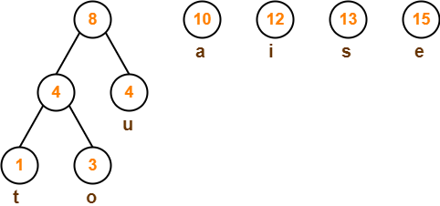
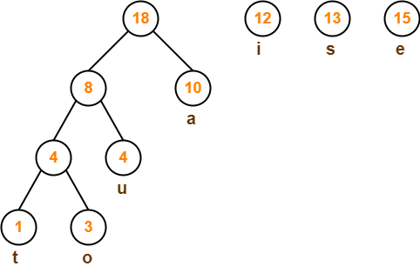
Step3:
Greedy methods – Huffman codes algorithm
Step4:

Slide 15
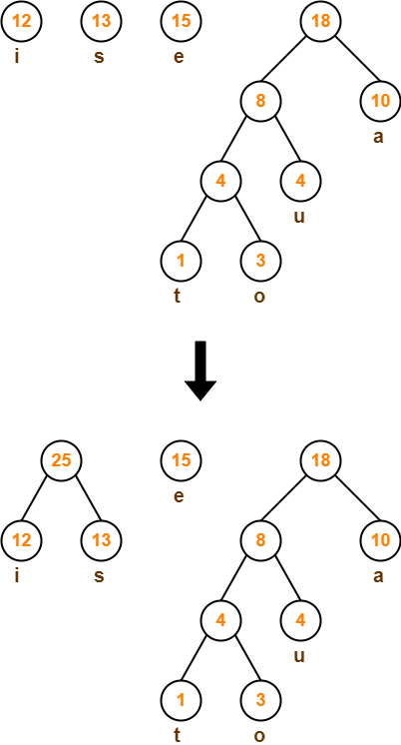
Step5:
Greedy methods – Huffman codes algorithm

Slide 16
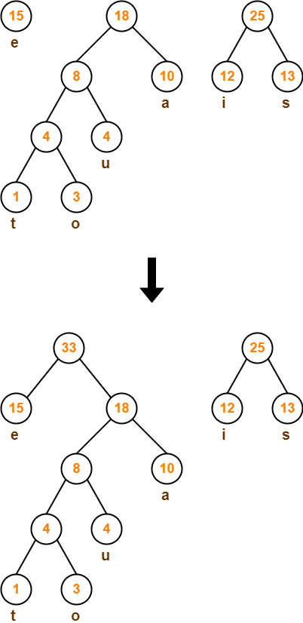
Step6:
Greedy methods – Huffman codes algorithm

Slide 17
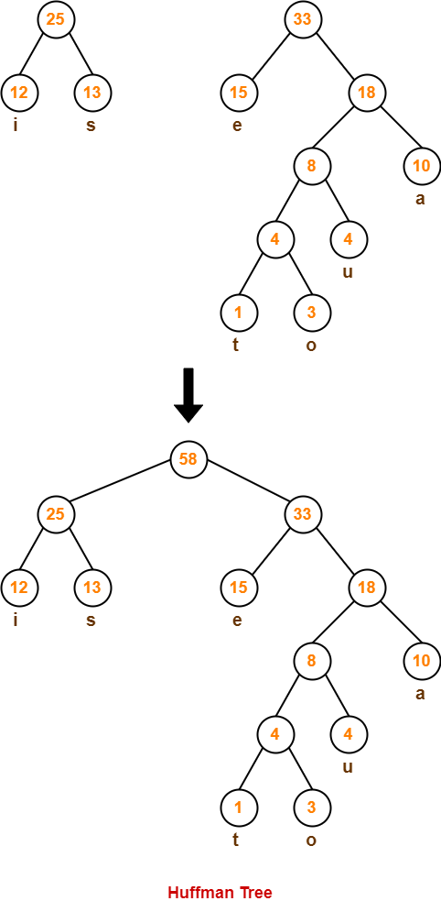
Step7:
Greedy methods – Huffman codes algorithm

Slide 18
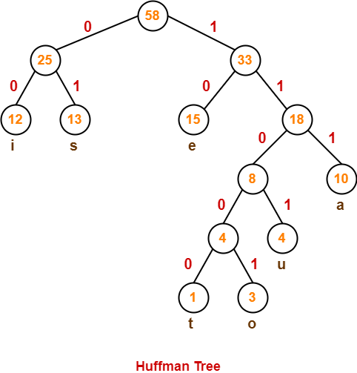
Now, We assign weight to all the edges of the constructed Huffman Tree. Let us assign weight ‘0’ to the left edges and weight ‘1’ to the right edges.
Greedy methods – Huffman codes algorithm
After assigning weight to all the edges,
the modified Huffman Tree is-

Slide 19
1. Huffman Code For Characters-
Greedy methods – Huffman codes algorithm
To write Huffman Code for any character, traverse the Huffman Tree from root node to the leaf node of that character.
Following this rule, the Huffman Code for each character is-
a = 111
e = 10
i = 00
o = 11001
u = 1101
s = 01
t = 11000

Slide 20
2. Average Code Length-
Greedy methods – Huffman codes algorithm
Average code length
= ∑ ( frequency_{i} x code length_{i} ) / ∑ ( frequency_{i} )
= { (10 x 3) + (15 x 2) + (12 x 2) + (3 x 5) + (4 x 4) + (13 x 2) + (1 x 5) } / (10 + 15 + 12 + 3 + 4 + 13 + 1)
= 2.52

Slide 21
3. Length of Huffman Encoded Message-
Greedy methods – Huffman codes algorithm
Total number of bits in Huffman encoded message
= Total number of characters in the message x Average code length per character
= 58 x 2.52
= 146.16
≅ 147 bits

Slide 22
Algorithm :
Greedy methods – Huffman codes algorithm
Huffman(c)
{
n = |c|;
Make a min heap Q with c;
For i = 1 to n-1
allocate a new node z;
z.left = x = extract-min(Q);
z.right = y = extract-min(Q);
z.freq = x.freq + y.freq;
Insert(Q,z);
Return(extract-min(Q))
}

Slide 23
Time complexity:
Greedy methods – Huffman codes algorithm
For build a min heap = O(n)
For extract-min = O((n-1)2(logn)) = O(nlogn)
For insert = O((n-1)logn) = O(nlogn)
So time complexity of Huffman algorithm is O(nlogn)

Slide 24
(3.)Job Sequencing Problem with Deadline:
Greedy methods – Job sequencing problem with deadline algorithm
This problem consists of n jobs each associated with a deadline and profit and our objective is to earn maximum profit. We will earn profit only when job is completed on or before deadline. We assume that each job will take unit time to complete.
Points to remember:-
i) In this problem we have n jobs j1, j2, … jn each has an associated deadline d1, d2, … dn and profit p1, p2, ... pn.
ii) Profit will only be awarded or earned if the job is completed on or before the deadline.
iii)We assume that each job takes unit time to complete.
iv)The objective is to earn maximum profit when only one job can be scheduled or processed at any given time.

Slide 25
Example problem:
Greedy methods – Job sequencing problem with deadline algorithm
Consider the following 5 jobs and their associated deadline and profit.
Step 1. Sort the jobs according to their profit in descending order
index | 1 | 2 | 3 | 4 | 5
JOB | j1 | j2 | j3 | j4 | j5
DEADLINE | 2 | 1 | 3 | 2 | 1
PROFIT | 60 | 100 | 20 | 40 | 20
index | 1 | 2 | 3 | 4 | 5
JOB | j2 | j1 | j4 | j3 | j5
DEADLINE | 1 | 2 | 2 | 3 | 1
PROFIT | 100 | 60 | 40 | 20 | 20

Slide 26
Step 2. Find the maximum deadline value
Greedy methods – Job sequencing problem with deadline algorithm
Here dmax = 3
As dmax = 3 so we will have THREE slots to keep track of free time slots. Set the time slot status to EMPTY.
Step 3.
Now our job is to take the job of highest profit and place it as far ass possible
So profit is 180 which is maximum.
time slot | 1 | 2 | 3
status | EMPTY | EMPTY | EMPTY
time slot | 1 | 2 | 3
status | j2 | j1 | j3

Slide 27
Algorithm:
Greedy methods – Job sequencing problem with deadline algorithm
Job-sequencing-with-deadline(j[1….n],p[1….n],d[1…..n],n)
{
Sort jobs in decreasing order of profit
For i = 1 to n
find maximum deadline and put it in dmax;
For i = 0 to dmax
x[i] = 0;
For i = 1 to n in sorted list of jobs
For k = di to 0
if(x[k]==0)
x[k] = ji;
break;
Return profit associated with all the jobs present in array x;
}

Slide 28
Time complexity:
Greedy methods – Job sequencing problem with deadline algorithm
For sorting the jobs in decreasing order of profit:-O(nlogn)
For finding max deadline = O(n)
For creating array x and make all entries 0 = O(dmax)
For last for loop in algorithm:- we have to take each job and start searching a vacant a lot from its deadline to 0 so in worst case it can happen that we have n jobs and we have to perform n searches for each job then time complexity will be O(n^2)
So the time complexity for this algorithm is O(n^2).

Slide 29
(4.)Optimal merge pattern algorithm:
Greedy methods – Optimal merge pattern algorithm
Given n number of sorted files, the task is to find the minimum number of record movements done to reach Optimal Merge Pattern. When two or more sorted files are to be merged all together to form a single file, the minimum computations done to reach this file are known as Optimal Merge Pattern.
If more than 2 files need to be merged then it can be done in pairs. For example, if need to merge 4 files A, B, C, D. First Merge A with B to get X1, merge X1 with C to get X2, merge X2 with D to get X3 as the output file.

Slide 30
Example problem:
Greedy methods – Optimal merge pattern algorithm
Let us consider the given files, f₁, f₂, f₃, f₄ and f₅ with 20, 30, 10, 5 and 30 number of elements respectively. We have to merge all the files in a single file with minimum number of record movements possible.
sorting the numbers according to their size in an ascending order, we get the following sequence −
f₄, f₃, f₁, f₂, f₅
Hence, merge operations can be performed on this sequence
M₁ = merge f₄ and f₃ => 5 + 10 = 15
M₂ = merge M₁ and f₁ => 15 + 20 = 35
M₃ = merge M₂ and f₂ => 35 + 30 = 65
M₄ = merge M₃ and f₅ => 65 + 30 = 95
Therefore, the total number of record movements is 15+35+65+95 = 210 which is minimum.

Slide 31
Algorithm:
Greedy methods – Optimal merge pattern algorithm
Tree(n)
{
Make a min heap Q with n;
For i = 1 to n-1
declare a new node z;
z.left = x = extract-min(Q);
z.right = y = extract-min(Q);
z.weight = x.weight + y.weight;
Insert(Q,z);
Return extract-min(Q);
}

Slide 32
Time complexity:
Greedy methods – Optimal merge pattern algorithm
For build a min heap = O(n)
For extract-min = O((n-1)2(logn)) = O(nlogn)
For insert = O((n-1)logn) = O(nlogn)
So time complexity of optimal merge pattern algorithm is O(nlogn)

